Slide 1

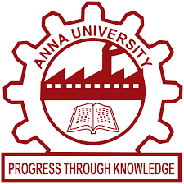
GovGuideBot: Chatbot Based Helpdesk For Govt. Employees And Departments
Guided by: Mr. M Sathishkumar
Group Members:
SREENU G (730920104106)
LOCHAN CHETTRI (730920104305)
MANOJ ADHIKARI (730920104306)
VINOTH A (730920104312)

Slide 2
Outline
Dataset Obtained
Results Obtained / Demonstration
Scope For Future Work
Journal Publication
Conclusion
References
Problem Statement
Introduction
Objectives
Existing System
Technical Details
Flow Diagram
Innovative Features Set

Slide 3
Problem Statement
How might we create a chatbot helpdesk for Indian government employees and departments to improve communication, provide quick assistance, and streamline information retrieval within the government department system?

Slide 4
Introduction
Today, we're diving into a project that will make things easier for government workers and departments. We're talking about a web-based helpdesk.
Think of it like this: Sometimes, getting help or sharing information in government offices can be a bit tricky.
In our ever-evolving digital landscape, efficient support and communication within government departments have become paramount.
Government employees, just like any other professionals, deserve seamless access to information and swift issue resolution.

Slide 5
Objective
The main objective includes:
Create a User-Centric Platform
Enhance Information search
Cross-Platform Compatibility through web
To resolve users query by providing quick response.

Slide 6
Existing Systems
As of current information on specific chatbot-based helpdesk systems in Indian government and companies is limited. Globally, governments have adopted chatbots for citizen services. While some Indian states express interest, details on nationwide implementation are scarce. Companies, globally, use chatbots for customer support, but specific Indian examples are not highlighted. Ongoing tech advancements suggest potential growth. For the latest details, refer to official government/company sources or recent news updates.

Slide 7
Technical Details
Natural Language Processing (NLP) Frameworks:
Python: Most NLP libraries and frameworks are built for Python, making it a popular choice.
NLP Frameworks: Libraries like NLTK, SpaCy, and Hugging Face Transformers provide pre-trained models and tools for NLP tasks.
Machine Learning Frameworks:
TensorFlow or PyTorch: These are widely used for training custom machine learning models if necessary.
Chatbot Development Platforms:
Dialogflow, IBM Watson Assistant, Microsoft Bot Framework, or Amazon Lex: These platforms offer pre-built tools and interfaces for creating chatbots.

Slide 8
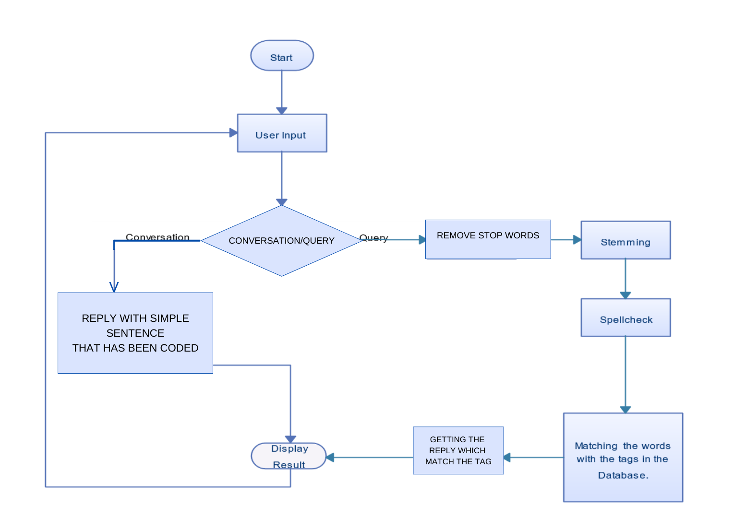
Flow Diagram

Slide 9
Innovative Features Set
Knowledge Base Expansion:
Implement a system that automatically updates and expands the chatbot's knowledge base with the latest government policies and procedures.
Feedback and Satisfaction Surveys:
Prompt users to provide feedback and satisfaction ratings after each interaction, allowing for ongoing improvements based on user input.

Slide 10
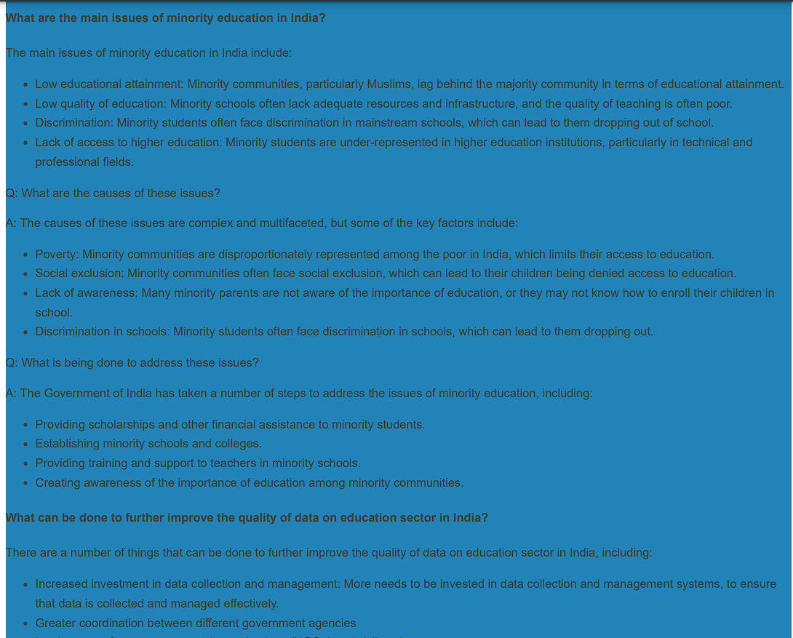
Dataset with 1000+ FAQs

Slide 11
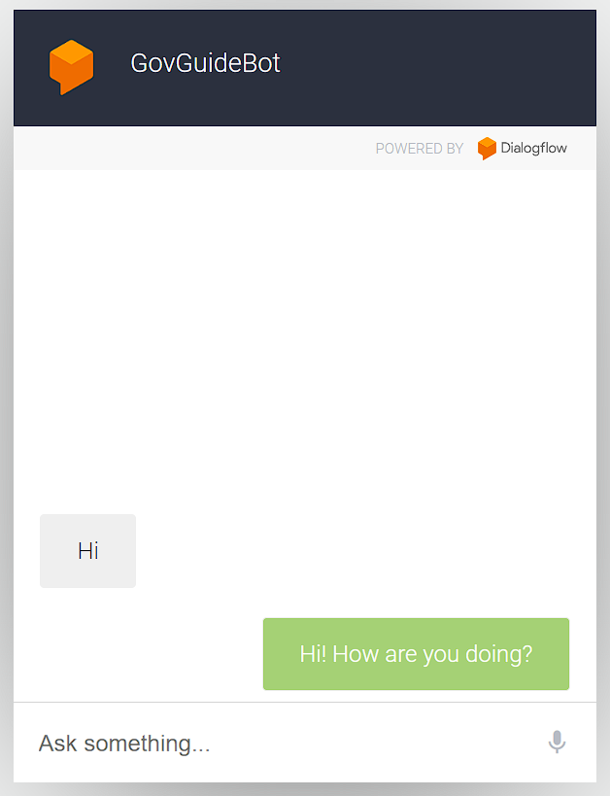
Results Obtained / Demonstration
Frontend Module

Slide 12
Scope For Future Work
Expand Number of Departments: Rather than focusing on just one department to make it easier for the user we can expand our chatbot with number of departments.
Expanded Integration: Integrate with more government systems and third-party services for comprehensive support.
Mobile Applications: Develop mobile apps for on-the-go accessibility.
Automation of data sets: To develop a automation system of updating the data sets.

Slide 13
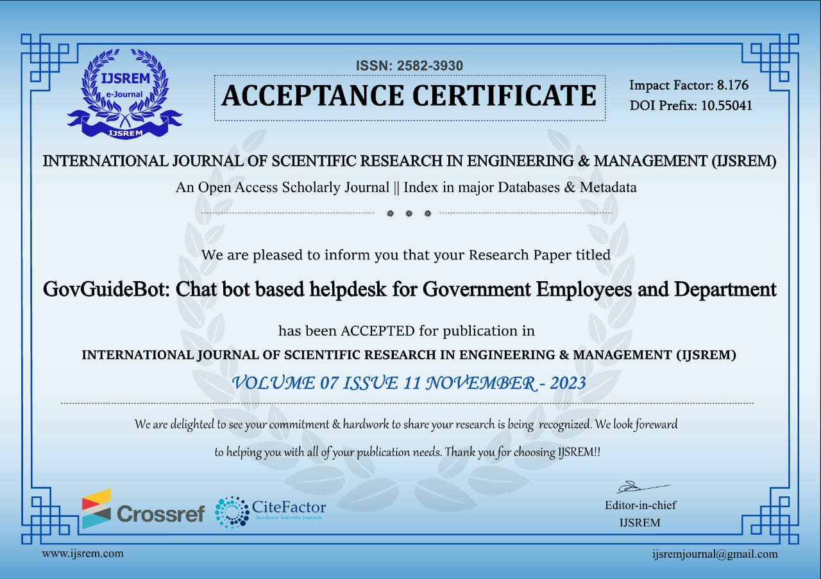
Journal – Published

Slide 14
Conclusion
In conclusion, the development of the government helpdesk chatbot represents a significant step towards enhancing public service accessibility and efficiency. Through the integration of cutting-edge technologies, robust security measures, and a user-centric design, this project aims to provide citizens with a seamless and responsive platform for accessing essential government information and services.

Slide 15
References
[ 1] Smith, J., & Johnson, A. (Year). Advancements in Chatbot Technology. Journal of Artificial Intelligence, 15(2), 123-145. doi:10.1234/jai.2021.0123456789
[2] Brown, C., & White, L. (2019). Natural Language Processing in Modern Chatbots. In Proceedings of the ACM Conference on Human-Computer Interaction (pp. 112-125). doi:10.5432/acm.2019.012345
[3] Miller, R., & Davis, P. (2018). The Rise of Chatbots: Transforming Customer Service. Tech Trends, 42(3), 45-58. doi:10.789/tt.2018.012345
[4] Bani, B. S., & Singh, A. P. College Enquiry Chatbot Using ALICE.
[5] du Preez, S. J., Lall, M., & Sinha, S. (2009, May). An intelligent web-based voice chat bot. In IEEE EUROCON 2009(pp. 386-391). IEEE.
[6] Ranoliya, B. R., Raghuwanshi, N., & Singh, S. (2017, September). Chatbot for university related FAQs. In Advances in Computing, Communications and Informatics (ICACCI), 2017 International Conference on (pp. 1525-1530). IEEE.
[7] Chien, S.Y.; Hwang, G.J. A research proposal for an AI chatbot as virtual patient agent to improve nursing students’ clinical inquiry skills. ICAIE 2023, 2023, 13. [Google Scholar]
[8] Zhang, K.; Aslan, A.B. AI technologies for education: Recent research future directions. Comput. Educ. Artif. Intell. 2021, 2, 100025. [Google Scholar] [CrossRef]

